Slide 1

Brittle Failure, Ductile Failure and Energy Competition Mechanism
Xuan Hu
Advisor: Shaofan Li

Slide 2
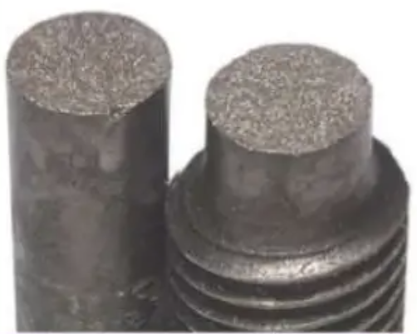

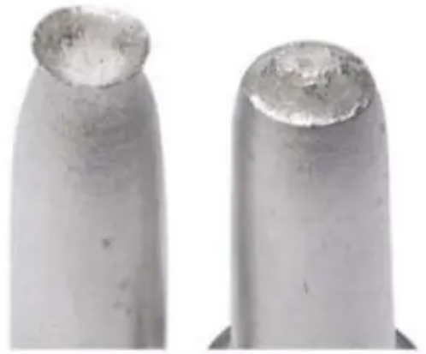
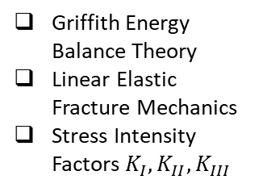
Experiments
Theories
Numerical Tools
Brittle Failure
without any warnings
Griffith Energy Balance Theory
Linear Elastic Fracture Mechanics
Stress Intensity Factors $K_{I},K_{II}, K_{III}$
Extended Finite Element Method
Ordinary Bond-Based Peridynamics
Phase Field Model Based on SED
My Proposal:
Energy Competition
Mechanism
Crystalline Materials
J Contour Integral Method
Crack-Tip-Opening Displacement
Crack-Growth Resistance Cuvers
Finite Element Cohesive Zone Model
Non-Ordinary State-Based Peridynamics
Molecular Dynamics in Atomistic Scale
Ductile Failure
after large deformation

Slide 3






Energy Competition between decohesion & dislocation
For brittle materials, $E_{decohesion}$ is smaller
Bonds break due to stretch
$$γ_{s}$$
decohesion
$$γ_{us}$$
BRITTLE
FAILURE
dislocation
Meso-Scale
Macro-Scale
For ductile materials, $E_{dislocation}$ is smaller
Bonds break due to parallel shift
$$γ_{s}$$
decohesion
$$γ_{us}$$
dislocation
DUCTILE
FAILURE
Research goals:
Construct a unified numerical model for computation
Reveal the relation between brittle and ductile failures
Guide the development of high ductility materials

